Slide 1
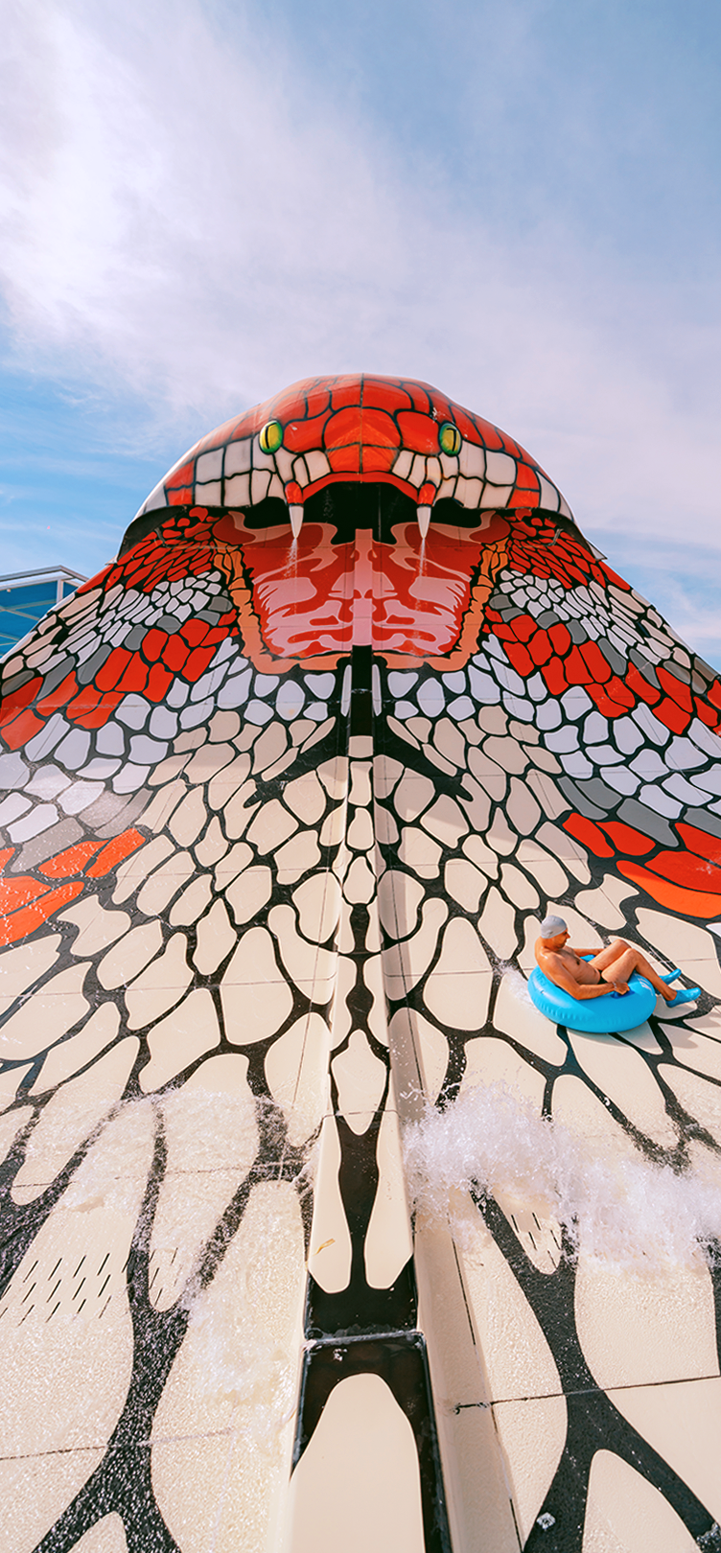
Beverages
Meals
Neverland
Jungle bar
Coffee/Soft drinks from 10:00 to 02:00
Columbus
Soft drinks/Cocktails from 8:00 to 0:00
Red Sky
Shisha/ Soft drinks from 18:00 to 23:00
Colonies
Soft drinks/ Cocktails from 18:00 to 0:00
La Veranda
Soft drinks/ Cocktails from 10:00 to 17:00
Orange Bar
Soft drinks/ Cocktails from 10:00 to 21:00
Beach Bar
Soft drinks / Cocktails from 10:00 to 17:00
Lobby Bar
Coffee/ Soft drinks 24 hours
Bakery Bar
Coffee / Soft drinks from 8:00 to 0:00
Alcoholics from 10:00 to 0:00
Fresh Bakery from 11:00 to 21:00
. Terrace bar from 11:00 to 0:00 . Giraffe Bar from 10:00 to 0:00
Water Valley Bar
Soft drinks / Cocktails from 10:00 to 17:00
Alf Leila Wa Leila
Tamraya
Alcoholic drinks /Tea time/cake from 10:00 to 0:00
Hot/soft drinks 24 hours
Jazz Bar
Soft drinks/Cocktails from 10:00 to 0:00
Tea time/cake from 15:00 to 18:00
Afendina
Shisha/soft drinks from 15:00 to 0:00
La Veranda
Soft drinks/Cocktails from 18:00 to 0:00
Oasis Bar
Soft drinks/ Cocktails from 10:00 to 17:00
Club MC
Soft drinks/ Cocktails from 10:00 to 17:00
Columbus
Soft drinks/ Cocktails from 10:00 to 0:00
Neverland
Breakfast
Soprano Restaurant from 08:00 to 10:30
Zum Kaiser from 07:00 to 10:00
Le Marche from 08:00 to 10:00
Mediterranean from 07:00 to 10:00
Alfredo from 08:00 to 10:00
Tagine from 07:00 to 10:30
Lunch
Soprano Restaurant from 12:30 to 14:30
Zum Kaiser from 12:30 to 14:30
Le Marche from 12:30 to 14:30
Mediterranean from 12:30 to 14:30
Dinner
Soprano Main Restaurant from 18:30 to 21:00
Zum Kaiser from 18:00 to 21:00
Le Marche from 18:30 to 21:00
Mediterranean from 18:00 to 21:00
Alfredo from 18:30 to 21:00
Tagine from 18:00 to 21:00
L’Asiatique from 18:30 to 21:00
Taj from 19:00 to 21:00
Soprano (late dinner) from 22:00 to 0:00
Snacks
Aqua Park Bar from 15:00 to 17:00
Water Valley Bar from 12:00 to 16:00
Rockin Burger from 12:00 to 15:00
from 18:00 to 21:00
Alf Leila Wa Leila
Breakfast
La Marche from 07:00 to 11:00
Mediterranean from 08:00 to 10:00
Lunch
La Marche from 12:30 to 14:00
Dinner
La Marche from 18:00 to 21:00
La Casa from 18:00 to 21:00
L’Asiatique from 18:30 to 20:15
Mediterranean (late dinner) from 22:00 to 0:00
Snacks
Club MC from 12:00 to 16:00
Beach Bar from 12:00 to 14:30
ALL
INCLUSIVE FORMULA
T: +20 6534646602-5
H: +20 15787
E: SALES@PICKALBATROS.COM
PICKALBATROS.COM

Slide 2
ACTIVITIES
IMPORTANT TO KNOW
Dress Code
The dress code around the hotel’s public areas and
restaurants are smart casual; gentlemen are kindly
requested to wear long trousers. Singlets, pool attire, and slippers are not permitted in the restaurant during dinnertime
Towel Cards
In case of loss, damage, or no return to the reception
upon checkout, US$ 15 will be charged to your bill
* services with extra charge
All the above information is subject to prior confirmation.
. Reception
Available 24/7
Tel : 0-3-791-793 801-802-803
. WiFi
Connected with Room Nu - family Name –Email Address
. Extra charge
Room Service - Cold stone ice cream – Turkish coffee
Gymnastics daily at 10:00
Water Polo daily at 15:15
Fitness daily at 10:30
Step Aerobic daily at 15:30
Darts daily at 11:00
Volleyball daily at 15:45
Dance Lesson daily at 11:30
Yoga daily at 16:00
Aqua Gym daily at 12:00
Cocktail Game daily at 12:30
Kids Club daily from 10:00 to 12:30 & from 15:00 to 16:30 (children under 4 y.o. must be accompanied by parents)
ART SCHOOL daily from 12:30 to 21:00 at the Midway.
Check-Out Time
Check-out time is 12:00. For late check-out please
contact Reception for advice on the extra charge.
Laundry, Dry Cleaning, And Valet Services
Laundry bags and price lists are located on the armoire shelves; if your laundry is received by 09:00, it will be returned to you on the same day at 18:00
SPA & GYM
Gym & Heated Pool are Free Of Charge from 07:30 to 20:00.
Sauna / Steam / Hammam ( all Spa services ) are charged extra.
NB:
Kindly note that the SPA is an Adults only zone.
Safe Box
We recommend placing all your valuables inside your room safe, usage instructions are displayed on the safe box door
Doctor
The clinic is open 24 hours, 7 days a week.
Doctors’ consultation at the clinic is available 24 hours. Should you require any medical assistance, please contact Guest Relations at the magic button. The concierge can help you obtain any prescriptions you may require
NB:
Other Beach Activities: Beach football, Beach Tennis, Tennis table & Sunset Music.
ENTERTAINMENT
Kids Cinema (Taj Restaurant) from 15:00 till 21:00 daily.
Kid’s Movies from 18:30 at the Wave stage and Italian restaurant terrace.
Face painting from 19:30 in the Midway.
Mini-disco at The Midway Stage daily at 20:15.
DJ performance at The Amphitheater Stage daily at 21:00.
Evening Show at The Amphitheater Stage daily at 21:30.

